Slide 1
Computer Architecture
A Quantitative Approach
Chapter 5
Multiprocessors

Slide 2
Outline
Coherence
Write Consistency
Snooping
Building Blocks
Snooping protocols and examples
Coherence traffic and Performance on MP
Directory-based protocols and examples
Conclusion

Slide 3
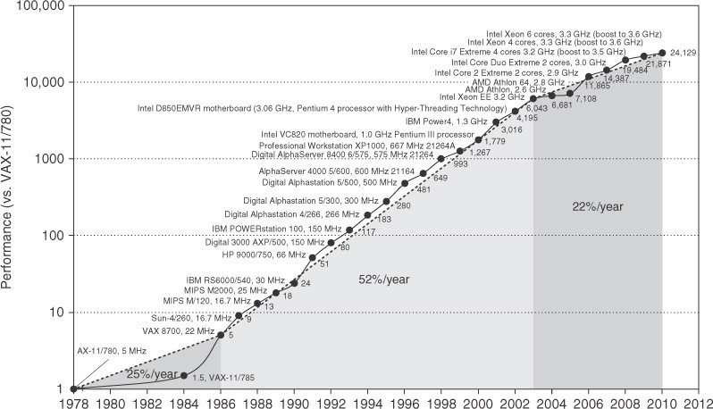
Uniprocessor Performance (SPECint)
From Hennessy and Patterson, Computer Architecture: A Quantitative Approach, 5th edition, 2012
Power & Limited ILP
VAX : 25%/year 1978 to mid-1980 (architectural and organizational idea)
RISC + x86: 52%/year 1986 to 2002; 22%/year 2002 to present

Slide 4
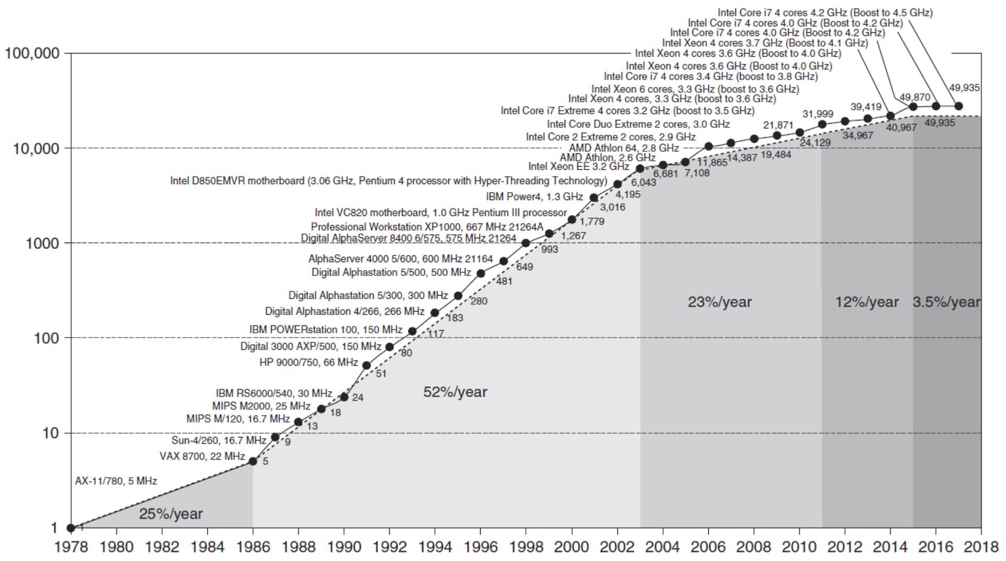
Uniprocessor Performance (SPECint)
From Hennessy and Patterson,
Computer Architecture: A Quantitative
Approach, 6th edition
Power & Limited ILP
VAX : 25%/year 1978 to mid-1980 (architectural and organizational idea)
RISC + x86: 52%/year 1986 to 2002; 25%/year 2002 to 2010
Notes:
>>
(From Chapter 1)
Uniprocessor performance growth (SPECint) slowed from a high of
52% per year (1986 to 2002) to
23% per year (2002 to 2010).
Clock Rate Stagnation:
After 2003, clock rate growth dropped significantly to about 2%/year.
This contrasts sharply with the ~40%/year growth seen in the preceding decade.
The Problem: The Power Wall
The slowdown is due to power constraints and limited Instruction-Level Parallelism (ILP).

Slide 5
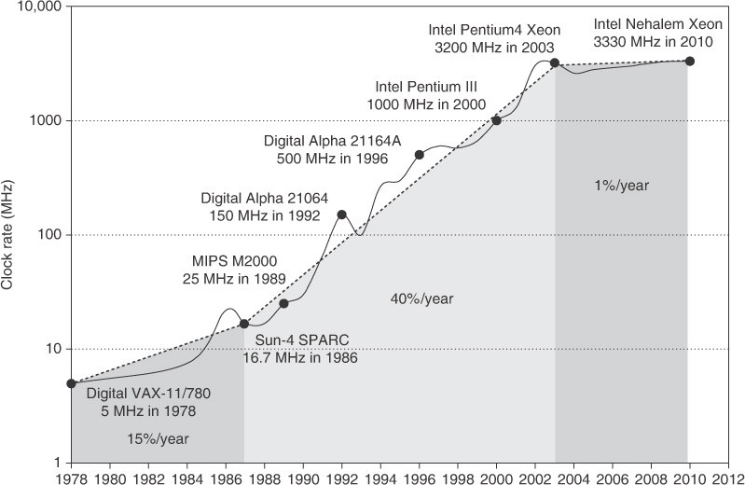
Growth in Clock Rate of Microprocessors
From Hennessy and Patterson,
Computer Architecture: A Quantitative
Approach, 5th edition

Slide 6
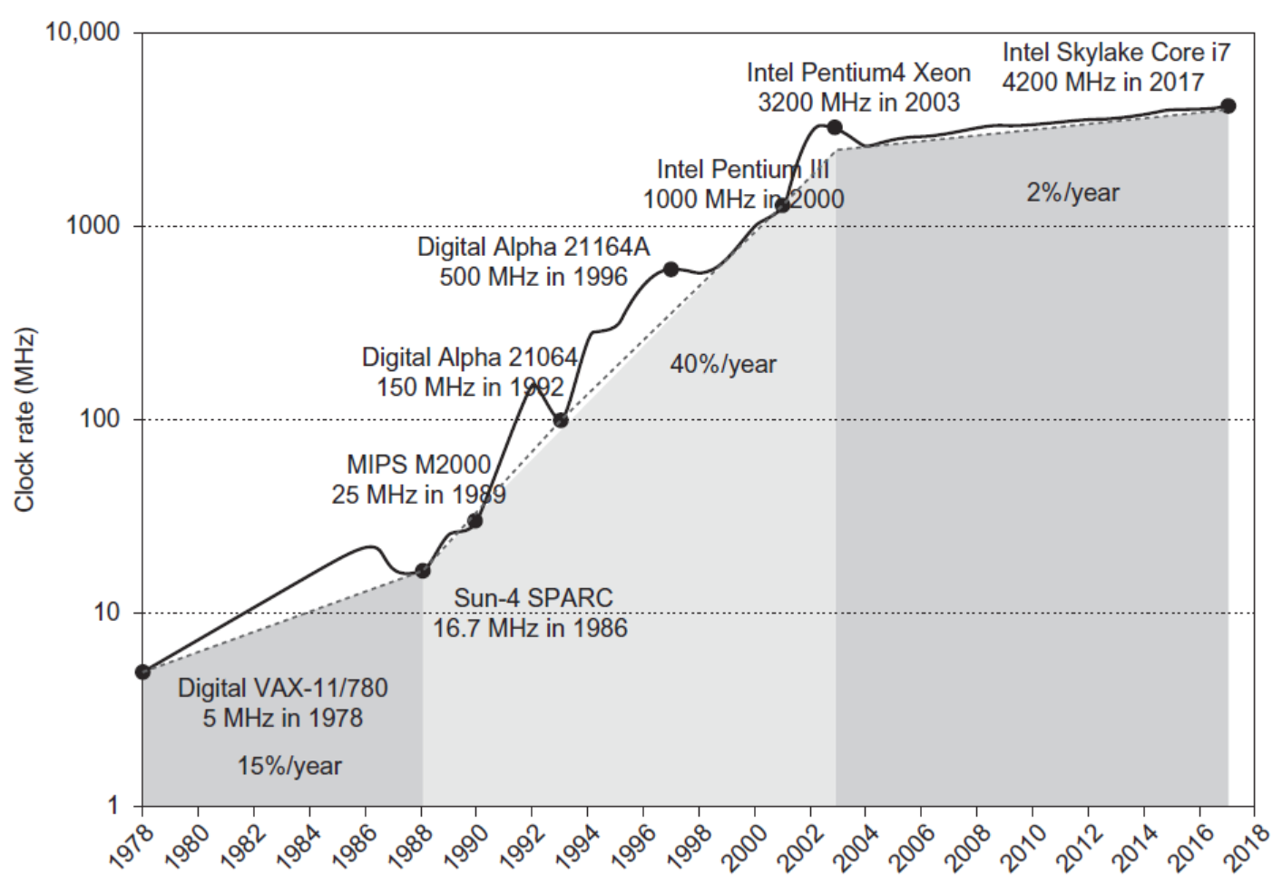
Growth in Clock Rate and Power
From Hennessy and Patterson,
Computer Architecture: A Quantitative
Approach, 6th edition
Notes:
>>
(From Chapter 1)
Clock Rate and Power
Power Consumption:
The power consumed by CPUs grew dramatically:
1985: Intel 80386 (i386) consumed about 2 W
2014: 3.3 GHz Intel Core i7 consumes 130 W
Thermal Limit:
Heat from 130 W must be dissipated from a small 1.5 x 1.5 cm chip.
This power density represents the limit of what can be cooled by air.

Slide 7
Déjà vu all over again?
“… today’s processors … are nearing an impasse as technologies approach the speed of light..”
- David Mitchell, The Transputer: The Time Is Now (1989)
Transputer was premature
⇒ Custom multiprocessors strove to lead uniprocessors. 2x perf / 1.2 yr
“We are dedicating all of our future product development to multi- core designs. … This is a sea change in computing”
- Paul Otellini, President, Intel (2004)
Difference is all microprocessor companies switched to multi-core (AMD, Intel, IBM; all new Apples 2-4 CPUs)
⇒ 2X sequential perf. / 5 yrs
⇒ Biggest programming challenge: 1 to 2 CPUs
Notes:
>>
The Solution: Shift to Multi-Core
The shift to multi-core designs was declared a "sea change in computing" by Intel in 2004.
All major microprocessor companies (AMD, Intel, IBM) switched to multi-core designs.
Multi-Core Designs:
Since increasing clock speed was no longer feasible, the industry adopted Thread-Level Parallelism using multi-core designs.
This approach executes multiple independent threads simultaneously on different cores.
Performance Result:
The shift resulted in a 2X sequential performance gain every five years.
Key Challenge:
The largest programming hurdle now is scaling performance from a single CPU (or core) to two CPUs.

Slide 8
Other Factors ⇒ Multiprocessors Work Well
Growth in data-intensive applications
  Databases, file servers, web servers, … (All: many separate tasks)
Growing interest in servers, server performance
Increasing desktop performance less important
  Outside of graphics
Improved understanding in how to use multiprocessors effectively
– Especially servers, where significant natural TLP (separate tasks)
Huge cost $$$ advantage of leveraging design investment by replication
  Rather than unique designs for each higher performance chip
(a fast new design costs billions of dollars in R&D and factories)
Notes:
Factors favoring multiprocessors include:
Growth in data-intensive applications (databases, web servers) which have natural Thread-Level Parallelism (TLP)
Growing interest in server performance
and the huge cost advantage of leveraging design investment by replication (using the same MicroProcUnit) instead of unique, high-performance designs.

Slide 9
Flynn’s Taxonomy
M.J. Flynn, "Very High-Speed Computers", Proc. of the IEEE, V 54, 1900-1909, Dec. 1966.
M.J. Flynn and Kevin W. Rudd “Parallel Architectures” ACM Computing Surveys, Vol 28, No. 1 Mar. 1996.
Flynn classified by data and control streams in 1966
Single Instruction Stream, Single Data Stream (SISD) (Uniprocessors) | Single Instruction Stream, Multiple Data Stream SIMD (Single ProgCtr: CM-2)
Multiple Instruction Stream, Single Data Stream (MISD) (??? Arguably, no designs) | Multiple Instruction Stream, Multiple Data Stream MIMD (Clusters, SMP servers)
SIMD ⇒ Data Level Parallelism (problem: locked step)
MIMD ⇒ Thread Level Parallelism (independent steps)
MIMD popular because
  Flexible: N programs or 1 multithreaded program
  Cost-effective: same MicroProcUnit in desktop PC & MIMD
Notes:
>>
In the 1960s, Michael J. Flynn found a simple parallel computing classification that we still use today,
which targets Data-Level Parallelism and Thread-Level Parallelism.
Data-Level Parallelism
involves performing the same operation on different pieces of data simultaneously.
Thread-Level Parallelism
involves executing multiple independent threads concurrently on different processing cores.
By analyzing the parallelism in the instruction and data streams called for by the instructions at the most constrained component of the multiprocessor, …
All computers can be placed in one of four categories:
1. SISD: Single instruction stream, single data stream
2. SIMD: Single instruction stream, multiple data streams
offers Data-Level Parallelism
(but operations are locked step)
Vector architectures
Multimedia extensions
Graphics processor units
Constraint:
The operations are typically in locked step, meaning all parallel units execute the identical instruction at the same time (e.g., in vector units or GPUs).
3. MISD: Multiple instruction streams, single data streams
No commercial implementation
4. MIMD: Multiple instruction streams, multiple data streams
offers Thread-Level Parallelism (independent steps),
making it popular, flexible, and cost-effective.
For reference:
Locked step refers to a principle in parallel computing where multiple processing units execute the same instruction at the exact same time (often in the same clock cycle), but on different pieces of data.
Because they must execute the same instruction simultaneously, units cannot independently follow different execution paths (e.g., one unit taking the if branch while another takes the else branch).
If a conditional is met for only some data elements, the other units must wait or be masked, leading to potential idle time.

Slide 10
Back to Basics
“A parallel computer is a collection of processing elements that cooperate and communicate to solve large problems fast.”
Parallel Architecture = Processor Architecture + Communication Architecture
Two classes of multiprocessors W.R.T. memory:
Centralized Memory Multiprocessor
  < few dozen processor chips (and < 100 cores)
  Small enough to share a single, centralized memory
Physically Distributed-Memory Multiprocessor
  Larger number of chips and cores than centralized class 1.
  BW demands ⇒ Memory distributed among processors
  Distributed shared memory ≤ 256 processors, but easier to code
  Distributed distinct memories > 1 million processors
  (Shared address space versus separate address spaces)
Notes:
>>
Parallel architecture is defined by how processors and communication are structured.
Essentially, Parallel Architecture is the sum of Processor Architecture and Communication Architecture.
Communication Architecture includes both network and system bus structures,
as it refers to the entire mechanism by which processors exchange data and coordinate.
(arrow down)
Multiprocessor systems are classified by their memory architecture,
which directly impacts how threads share and access data.
Two classes:
Centralized Memory Multiprocessor
Scale: It is primarily used for smaller systems, typically supporting less than a few dozen processor chips or fewer than 100 cores.
Memory: Shares a single memory
Bandwidth/Access: All cores contend for the same memory bus. (system bus)
(arrow down)
Physically Distributed-Memory Multiprocessor
Scale/Cores: Larger scale (chips and cores)
Memory: Distributes memory across the system
Bandwidth/Access: Distributes bandwidth to meet massive demand. (interconnection network)

Slide 11
Centralized vs. Distributed Shared Memory
Scale
P1
$
Pn
P₁
P_{n}
$
$
Mem
$
Mem
Interconnection network
Interconnection network
Mem
Mem
Centralized Memory (Dance Hall MP)
(Bad: all memory access delays are big)
Distributed Memory
(Good: most memory accesses are local & fast)
Notes:
>>
Centralized Memory
is "bad" because all memory access delays are large.
Structure:
It consists of multiple processors and caches connected to a single, unified memory via an interconnection network (typically a bus or crossbar switch).
(The system bus is the primary communication mechanism.)
Limitation: It is a contention bottleneck.
As the number of cores increases, the limited bandwidth of the bus cannot meet the increasing demand,
which is why this architecture doesn't scale well to massive systems.
Distributed Memory
is "good" because memory is distributed across the system, allowing most memory accesses to be local and fast.
Necessity:
This architecture is essential because it allows the total system memory bandwidth to scale with the number of processors,
(meeting the massive data demands of large-scale parallelism.)
For reference:
(Dance Hall MP)
The colloquial nickname describes the key limitation of the centralized memory architecture:
all processors must share access to the same memory bank, which creates heavy contention.
A crossbar switch is a switching device arranged in a matrix configuration, where multiple input and output lines intersect, forming a grid.
At each intersection (called a crosspoint), a switch can be closed to establish a direct connection between an input and an output.
This architecture enables flexible and simultaneous routing of signals in telecommunications, computing, and electronics.

Slide 12
Centralized Memory Multiprocessor
Also called symmetric multiprocessors (SMPs) because single main memory has a symmetric relationship to all processors
Large caches and a single memory can satisfy the memory demands of small number (<17) of processors using a single, shared memory bus
Can scale to a few dozen processors (<65) using a crossbar (Xbar) switch and many memory banks
Although scaling beyond that is technically conceivable, it becomes less attractive as the number of processors sharing centralized memory increases
Notes:
>>
Centralized Memory Multiprocessor is also known as Symmetric Multiprocessors (SMPs).
Scaling Limit:
While a single shared memory bus can satisfy the demands of a small number of processors < 17,
scaling beyond that (up to < 65 processors) using a crossbar switch becomes less attractive as the number of processors increases.
For reference:
A crossbar switch is an interconnection network used in computer architecture,
primarily to connect multiple processors to multiple memory banks in a Centralized Memory Multiprocessor system.
It allows any processor to access any memory bank without contention from other processors accessing different memory banks.
Function:
A crossbar switch is a non-blocking switch network that connects N inputs (e.g., processors) to M outputs (e.g., memory banks or other processors).
Structure:
It's a grid-like structure where horizontal lines (inputs) and vertical lines (outputs) intersect.
At each intersection, there is a small switch that can be opened or closed to establish a direct connection between a specific input and output.
Advantage (Concurrency):
It allows simultaneous, concurrent transfers as long as no two inputs try to access the same output at the same time.
This provides much higher memory bandwidth than a single shared bus.
Application:
In Centralized Memory Multiprocessors, it helps scale the system beyond the limits of a single shared bus, potentially accommodating up to around 65 processors by connecting them to many memory banks.
Limitation (Cost):
The number of switches required is N x M. As the number of processors (N) increases, the cost and complexity of the crossbar grow quadratically, making scaling beyond a few dozen processors less attractive.

Slide 13
Distributed Memory Multiprocessor
Pro: Cost-effective way to scale memory bandwidth
– If most memory references are to local memory and if much less than 10% of all memory references are writes to shared variables
Pro: Reduces latency of local memory accesses
Con: Communicating data rapidly between processors needs more complex hardware
Con: Must change software to take advantage of increased memory BW
Notes:
>>
Pros / Cons of Distributed Memory Multiprocessor
Pros:
Cost-effective way to scale memory bandwidth
and reduces latency of local memory accesses.
(arrow down)
Cons:
Needs more complex hardware for rapid data communication
and requires software changes to utilize the increased memory bandwidth.

Slide 14
Models for Communication and Memory Architecture
Communication occurs by explicitly passing (high latency) messages among the processors: message-passing multiprocessors
  e.g., warehouse-scale computers: memory of a processor cannot be directly accessed by another processor
Communication occurs through a shared address space (via loads and stores): distributed shared memory multiprocessors either
  UMA (Uniform Memory Access time)
  for shared address, centralized memory MP;
  Symmetric shared-memory architecture
  NUMA (Non-Uniform Memory Access time multiprocessor)
  for shared address, distributed memory MP;
  Distributed shared-memory (DSM) architecture
  (In past, confusion whether “sharing” meant sharing physical memory UMA {Symmetric MP “dancehall”} or sharing address space NUMA)
Notes:
>>
Message-passing multiprocessors
communicate via explicitly passed (high latency) messages; e.g., warehouse-scale computers.
(arrow down)
Distributed Shared Memory
communicates via a shared address space (via loads / stores).
Types of shared address space are:
UMA (Uniform Memory Access)
for centralized memory multiprocessor (Symmetric shared-memory)
NUMA (Non-Uniform Memory Access)
for distributed memory multiprocessor (Distributed shared-memory).

Slide 15
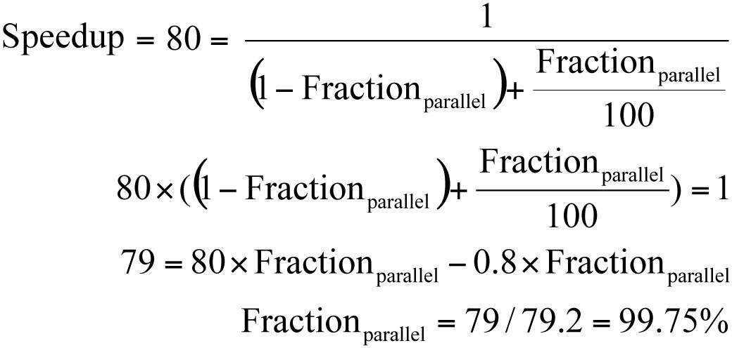
Challenges of Parallel Processing
First challenge: % of program that is inherently sequential
For 80X speedup from 100 processors:
What fraction of original program can be sequential?
  10%
b. 5%
Amdahl’s Law
c. 1%
d. 1/4%
Insufficient parallelism!!
Notes:
>>
The first challenge of parallel processing is knowing the percentage of the program that is inherently sequential.
Amdahl’s Law shows that for an 80X speedup from 100 processors;
the sequential fraction of the program must be only 1/4%.
Conclusion:
For most programs this means "Insufficient parallelism!!".

Slide 16
Challenges of Parallel Processing
Second challenge: long latency to remote memory
Suppose 32 CPU MP, 3.33GHz, 200 ns (= 666 clocks) for remote memory access, all local memory references are hit in the cache (assume HT = 0), and base CPI is 0.5.
How much faster is the system if 0.2% of instructions that access remote data, were local access instead?
1.4X
2.0X
3.6X
^{CPI}0.2% ^{= Base CPI}(no remote access) ⁺
Remote request rate x Remote request cost
CPI_{0.2%} = 0.5 + 0.2% x 666 = 0.5 + 1.3 = 1.8
No remote communication is 1.8/0.5 or 3.6 times faster than if 0.2% of instructions access one remote datum.
Long-latency remote communication !!
Notes:
>>
The second challenge of parallel processing (particularly with distributed shared-memory) is long latency to remote memory.
Architecture:
32 core multiprocessor at 3.33GHz
200 ns (= 666 clocks) for remote memory access
all local memory references are hit in the cache (assume hit time = 0)
and the base CPI is 0.5
CPI of 0.2% = Base CPI (no remote access) + Remote request rate * Remote request cost
CPI of 0.2% = 0.5 + 0.2% * 666 = 0.5 + 1.3 = 1.8
1.8 / 0.5 = 3.6 times faster
Conclusion:
The result is 3.6 times faster execution when using all local accesses for the 0.2% of instructions.
“Long-latency for remote communication !!".

Slide 17
Solving Challenges of Parallel Processing
Application parallelism ⇒ primarily need new algorithms with better parallel performance
Long remote latency impact ⇒ work for both the architect and the programmer
– Reduce frequency of remote accesses either by
» Caching shared data (HW)
» Restructuring the data layout to make more
accesses local (SW)
Will discuss first methods to reduce memory access latency via local caches
Notes:
>>
To solve the challenges of parallel processing,
Application parallelism needs new algorithms with better parallel performance.
(arrow down)
To mitigate long remote latency,
architects and programmers can reduce remote accesses by caching shared data (at the hardware level)
or restructuring data layout to make more accesses local (at the software level).

Slide 18
Symmetric Shared-Memory Architectures
Evolve from “multiple boards on a shared bus” to multiple processor “cores” on a single chip
Caches store both
  Private data used by a single processor
  Shared data used by multiple processors
Caching shared data can reduce:
  Latency to shared data
  Memory bandwidth for shared data, and
  Interconnect bandwidth needed
  But introduces cache coherence problem
Notes:
>>
Caches store both:
Private data used by a single processor
And shared data used by multiple processors
(arrow down)
Caching shared data reduces latency, memory bandwidth, and interconnect bandwidth for shared data.
However, caching shared data introduces the cache coherence problem.

Slide 19
Cache Coherence Problem: P₃ Changes U to 7
P₂
P
3
P₁
u = ?
u = ?
3
$
4
$
5
$
u :5 u=7
u :5
1
I/O devices
u:5
Memory
2
Processors see different values for u after event 3 (new 7 vs. old 5)
With write-back caches, value written back to memory depends on happenstance of which cache flushes or writes back value when
– Processes accessing main memory may see very “stale” values
Unacceptable for programming; writes to shared data often critical!
Notes:
>>
The Cache Coherence Problem occurs when multiple processors in a multiprocessor system have cached copies of the same shared data, and one processor writes a new value.
This leads to data inconsistency.
Scenario Steps:
(Variable u is initially 5)
P1 Reads u:
P1 reads u=5 from Memory.
(Memory u:5, P1 Cache u:5)
P3 Reads u:
P3 reads u=5 from Memory.
(Memory u:5, P3 Cache u:5)
P3 Writes u:
P3 writes a new value, u=7, to its local cache.
(P3 Cache $u:7$)
Inconsistency starts: Memory still holds u:5.
P1 Reads u:
P1's cached value is u=5 (stale/old).
The correct value is u=7.
P1 sees an inconsistent value (u=?).
P2 Reads u:
P2's cached value is u=5 (stale/old).
The correct value is u=7.
P2 sees an inconsistent value (u=?).
Multiple processors see different, inconsistent values for the same variable (u) after one processor writes a new value.
Write-Back Caches:
This problem is particularly acute with write-back caches,
where a write updates the local cache but not main memory immediately.
Consequence:
Processes accessing main memory may see "stale" values.
Verdict:
This is unacceptable for programming, as writes to shared data must be consistent and visible to all processors.

Slide 20
Example of Memory Consistency Problem
P₁
P₂
/*Assume initial values of A and flag are 0*/
A = 1;
flag = 1;
while (flag == 0); /*spin idly*/
print A;
Expected result not guaranteed by cache coherence
  Expect memory to respect order between accesses to different locations issued by a given process
  Also, expect memory to preserve orders among accesses to same location by different processes
Cache coherence is not enough!
– Pertains only to a single location
P₁ P₂ …
…
P_{n}
Conceptual
Picture
Mem with flag
Mem with A
Notes:
>>
Example (A=0, flag=0)
P1
A=1;
Flag=1;
P2
While(flag==0);
Print A;
Expected Result:
P1 executes A=1 before flag=1.
P2 must see A=1 before it sees flag=1.
The printed result must be A=1.
The Problem:
If the underlying hardware (e.g., a write buffer or reordering optimization) allows
P2 to see the write to flag before it sees the write to A,
P2 may exit the loop and print the stale value A=0.
Conclusion:
The expected result is not guaranteed by cache coherence alone.
Cache Coherence only ensures consistency for a single memory location (e.g., variable A).
A formal Memory Consistency Model is essential to ensure that all memory operations appear to occur in a predictable order to every processor.
This predictability is required to maintain the program order of accesses (like A and flag)
(to different memory locations by a single process, as well as the order of accesses to the same location by different processes.)
The Order Requirement:
For correct program execution, memory must respect:
Order between accesses to different locations (A and flag) issued by the same process (P1).
Order among accesses to the same location by different processes.

Slide 21
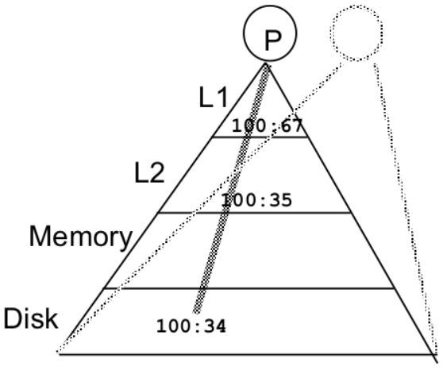
Intuitive Memory Model
Reading an address should return the last value written to that address
Easy in uniprocessors {except for DMA changes to I/O buffers}
Too vague and simplistic; two issues
Coherence defines values returned by a read
Consistency determines when each written value will be returned by a read from the same or a different PU.
  Coherence defines behavior to same location, and
  Consistency defines behavior to multiple locations
21
Notes:
>>
The Intuitive Memory Model:
The goal is when reading an address to return the last value written to that address.
Coherence vs. Consistency:
Coherence and Consistency are two distinct issues that must be addressed in multiprocessor systems:
Coherence defines the values returned by a read to the same location. (e.g., variable A).
Consistency determines when each written value will be returned and defines behavior to multiple locations. (e.g., A and flag).

Slide 22
Defining Coherent Memory System
Preserve Program Order: A write by processor P to location X followed by a read by P from X, if no write to X by another processor occurs between the write and the read by P, always returns the value written by P
Coherent view of memory: A write by one processor to location X followed by a read of X by another processor returns the newly written value if the read and write are sufficiently separated in time and no other writes to X occur between the two accesses
Write serialization: Two writes to same location by any two processors are seen in the same order by all processors
  For example, if the values 1 and then 2 are written to a location, processors can never read the value of the location as 2 and then later read it as 1 “Writes 1 => 2: same order everywhere”
  If not, a processor could keep value 1 if saw it as last write
Notes:
>>
A coherent memory system must satisfy three requirements:
Preserve Program Order
a processor reads its own write back.
(arrow down)
Coherent View of Memory
a processor reads another's new write.
(arrow down)
Write Serialization
two writes to the same location are seen in the same order by all processors.

Slide 23
Write Consistency (for writes to 2⁺ variables)
For now, assume:
A write does not complete (and allow any next write to occur) until all processors have seen the effect of that first write
The processor does not change the order of any write with respect to any other memory access
⇒ if one processor writes location A followed by location B, any processor that sees the new value of B must also see the new value of A
  These restrictions allow processors to reorder reads, but forces all processors to finish writes in program order
{Reads not change data => any order OK}
Notes:
>>
To enforce write consistency for multiple variables,
Write Completion Constraint:
A write operation must not complete (i.e., not allow any next write to occur) until all processors have seen the effect of that write.
(arrow down)
Program Order Constraint (Write-to-Write Order):
The processor does not change the order of any write with respect to any other memory access.
Implication:
Writes must be seen in the same order they were issued by the program (finish writes in program order).

Slide 24
Basic Schemes for Enforcing Coherence
A program on multiple processors will normally have copies of the same data in several caches
  Unlike I/O, where it’s rare
Rather than trying to avoid sharing in SW,
SMPs use a HW protocol to maintain coherent caches
  Migration and replication are keys to performance for shared data
Migration – (private) data can be moved to a local cache and used there in a transparent fashion
  Reduces both latency to access shared data that is allocated remotely and bandwidth demand on the shared memory and interconnection
Replication – for reading shared data simultaneously, since caches make a copy of data in local cache
  Reduces both latency of access and contention for read-shared data
  Like “mirror” sites for web downloads.
Notes:
>>
In a system with multiple processors, a single piece of data may exist in copies within several different processor caches.
Hardware Protocol for Coherence:
Symmetric Multiprocessors (SMPs) use a Hardware protocol to maintain coherence among the caches.
(This approach is favored over trying to avoid data sharing using software.)
(arrow down)
Migration and replication are key to performance for shared data.
Migration
Private data (when only one processor is using it) is moved (migrates) to a local cache and used there transparently.
This reduces both latency to access remotely allocated shared data and bandwidth demand on the shared memory and interconnection.
(arrow down)
Replication (copies for reading) are key performance drivers, reducing latency and bandwidth demand.
Used for reading shared data simultaneously.
Copies are made in local caches.
This reduces both latency of access and contention for read-shared data.

Slide 25
Two Classes of Cache Coherence Protocols
Snooping (“Snoopy”) — Every cache with a copy of a data block also has a copy of the sharing status of the block, but no centralized state is kept
  All caches have access to addresses of writes and cache-misses via some broadcast medium (a bus or cross-bar switch)
  All cache controllers monitor or snoop on the shared medium to determine whether or not they have a local cache copy of each block that is requested by a bus or switch access
Directory-based — Sharing status of a physical memory block is kept in just one location, the directory entry for that block
Notes:
>>
Coherence protocols maintain a consistent view of memory among multiple caches.
There are two classes of Cache Coherence Protocols:
Snooping ("Snoopy“)
Directory-based
(arrow down)
Snooping ("Snoopy"):
Every cache controller snoops on a shared bus (broadcast medium) for all memory transactions.
A write transaction broadcasts an invalidate signal to all other caches with a copy.
Best For: Small-scale SMPs.
Pros: Simple, fast response.
Con: Does not scale; the shared bus becomes a traffic bottleneck as the number of processors increases.
(arrow down)
Directory-based:
Sharing status is kept in a single location (the directory entry).
Mechanism:
A centralized directory tracks the sharing status (which caches have copies) of every memory block.
Communication is point-to-point: the directory forwards messages only to the specific, relevant caches (replaces broadcast).
Best For: Large-scale multiprocessors (NUMA).
Pros: Highly scalable, reduced bandwidth usage (no global broadcast).
Cons: Higher access latency (extra directory step), requires significant memory overhead for the directory.

Slide 26
Outline
Coherence
Write Consistency
Snooping
Building Blocks
Snooping protocols and examples
Coherence traffic and Performance on MP
Directory-based protocols and examples
Conclusion

Slide 27
SNOOPY
CACHE-COHERENCE PROTOCOL

Slide 28
Snoopy Cache-Coherence Protocols
Block State Address
P₁
P_{n}
Bus snoop
 |  | Data
$
$
Cache-memory
Mem
I/O devices
transaction
Cache Controller “snoops” on all transactions on the shared medium (bus or switch)
  Relevant transaction if it is for a block the cache (e.g., P₁) contains
  If relevant, a cache controller takes action to ensure coherence
» invalidate, update, or supply the latest value
  depends on state of the block and the protocol
A cache either gets exclusive access before a write via
write invalidate, or updates all copies when it writes
Notes:
>>
In Snoopy Cache-Coherence Protocol:
The Cache Controller "snoops" (monitors) all transactions on the shared medium (bus or switch).
If a snooped transaction is relevant (i.e., for a block the cache holds),
Depending on the block’s state the controller will either invalidate, update, or supply the latest value to ensure coherence.
Write Strategies:
A cache ensures coherence during a write using one of two methods:
Write Invalidate: The cache gets exclusive access before writing by invalidating all other copies.
Write Update: The cache updates all copies simultaneously when it writes.

Slide 29
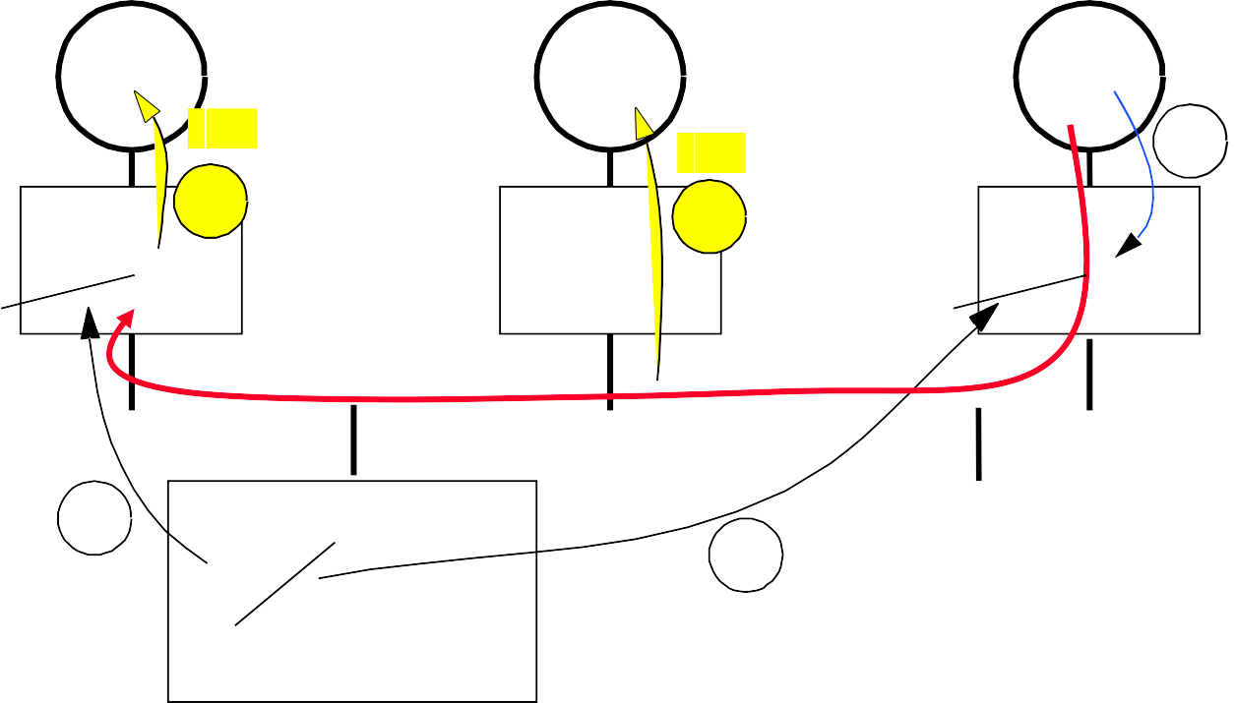
Example: Write-Thru Invalidate
P₁
P₂
P₃
u = ?
u = ?
3
$
4
$
5
$
u :5 u= 7
u :5
1
I/O devices
u:5
2
u = 7
Memory
Must invalidate at least P1’s cache copy u:5 before step 3
Write update uses more broadcast medium bandwidth (must share both full address and new value)
⇒ all recent MPUs use write_invalidate (send just cache block #)
Notes:
>>
Example of Write-Thru Invalidate
Scenario Steps:
(Variable u is initially 5)
P1 Reads u:
P1 reads u=5 from Memory.
(Memory u:5, P1 Cache u:5)
P3 Reads u:
P3 reads u=5 from Memory.
(Memory u:5, P3 Cache u:5)
P3 Writes u:
Must invalidate P1’s cache copy of u:5 FIRST!
P3 writes a new value, u=7, to its local cache.
(P3 Cache $u:7$)
More recent microprocessor units (MPUs) use write-invalidate
because write-update uses more broadcast medium bandwidth
(requiring both the full address and the new value).
Write-invalidate only sends the cache block number for the invalidation.

Slide 30
Architectural Building Blocks
Cache block state transition diagram
  Finite State Machine (FSM) specifying conditions of block state changes
  » Minimum number of states is 3: invalid, valid/shared, dirty
Broadcast Medium Transactions (e.g., bus)
  Fundamental system design abstraction
  Logically, a single set of wires connect several devices
  Protocol: arbitration, command/address, data
➔ Every device observes every transaction
Broadcast medium enforces serialization of read or write accesses ⇒ Write serialization
  1st processor to get medium (e.g., bus) invalidates others’ copies
  Implies that a write to shared item cannot complete until PU obtains bus
  Coherence schemes require serializing all accesses to the same cache block
Also need to find up-to-date copy of cache block
Notes:
>>
Cache Block State (FSM)
The coherence protocol is defined by a Finite State Machine (FSM)
which specifies conditions for block state changes.
The minimum number of states required is 3:
Invalid
Valid/Shared
Dirty
(arrow down)
Broadcast Medium (e.g., Bus)
The bus is a fundamental system abstraction where a single set of wires logically connects several devices.
Every device observes every transaction on the medium.
(arrow down)
The medium enforces serialization of accesses (both read and write).
Write Serialization:
The first processor to acquire the medium (e.g., bus) serializes its write and invalidates others' copies.

Slide 31
Locate up-to-date copy of data
Write-through (old): memory has up-to-date copy
  Write-through simpler logic if enough memory BW to support it
Write-back harder, but uses much less memory BW
  The most recent version of a cache block may not be in memory
Can use same snooping mechanism for write-back
  Snoop every address placed on the bus, as for write-through
  If a processor has “dirty” copy of a requested cache block, it provides it in response to a read request from another processor’s cache system and aborts the access to memory
  Complexity of retrieving cache block from a processor cache, which can take longer than retrieving it from memory
Write-back caches need lower memory bandwidths
  Support larger numbers of faster processors
  Most multiprocessor caches: write-back, maybe not L1➔L2
  All modern processors: write-back caches➔memory
Notes:
>>
Locating the Up-to-Date Copy of Data
The foundation of cache coherence relies on processors being able to find the correct, most recent version of any data block,
Which is handled differently depending on the cache's write policy.
The Problem of Data Location
In a multi-processor system, when a processor attempts to read a data block, the most recent copy may exist in one of three places:
Main Memory (RAM):
The simplest case, but often only true with the Write-Through policy.
A Local Cache:
The processor requesting the data may already have the up-to-date copy in its own cache.
Another Processor's Cache:
If a block has been modified by another processor but not written back to memory, it is "dirty" and must be retrieved directly from that other cache.
Two Core Write Policies
We address this data location problem using two main write policies,
each with a different implication for where the up-to-date copy resides:
Write-Through Policy (simpler)
Simpler Logic: Memory always has the up-to-date copy of the data.
Drawback: Requires high memory bandwidth (BW) to support it.
Write-Back Policy (more efficient)
Advantage: Uses much less memory BW.
Complexity: The most recent version of a cache block may not be in memory; it could be in a processor's cache.
(arrow down)
Locating Data (Snooping):
For write-back, the same snooping mechanism can be used to find the latest copy.
If a processor has the "dirty" copy of a requested block, it provides the block directly in response to the read request.
This action aborts the access to memory.
(arrow down)
Multiprocessor Use:
Most multiprocessor caches use write-back because the lower memory bandwidth requirement supports a larger number of faster processors.

Slide 32
Cache Resources for Write-Back Snooping
Normal cache indices+tags can be used for snooping
  But often have 2nd copy of tags (without data) for speed
Valid bit per cache block makes invalidation easy
Read misses are easy since they can rely on snooping
Writes (hit) ⇒ Need to know whether any other valid copies of the block are cached
  If no other copies ⇒ No need to (wait to) place write on bus for WB
  If other copies ⇒ Must wait for bus access to place invalidate on bus
Notes:
>>
Tags and Indices:
Normal cache indices and tags are used for the snooping process.
Optimization:
A second copy of the tags (without the data) is often maintained to allow for faster snooping without interfering with the CPU's memory loads.
(Tags are often duplicated to reduce interference with CPU memory loads.)
A Valid bit is used for each cache block, which makes the invalidation process straightforward.
(arrow down)
Read Misses are simple; they rely only on the standard snooping mechanism.
Write Hits require a check for other valid copies to determine the necessary action:
If no other valid copies exist:
The processor can write immediately without waiting for the bus.
If other valid copies exist:
The processor must wait for the bus access to place an invalidate command on the bus before completing the write.

Slide 33
Cache Resources for Write-Back Snooping (cont.)
To track whether a cache block is shared, add one more state bit to each cache block, like the valid and dirty bits (Dirty says block needs WB if replaced or read remotely)
  Write to Shared block ⇒ Put invalidate block# on bus and mark
  own cache copy of block as modified (valid but not in memory)
  Read miss => Put read miss block# on bus for memory to satisfy
» If another cache has a valid copy or if there is no “exclusive” option
in the protocol, mark new copy as “shared”
» Otherwise, mark new copy as exclusive (the only valid copy)
  No more invalidations are sent if CPU writes to its own modified
  or exclusive blocks; writes switch exclusive blocks to modified
  The last processor that modified a cache block is its owner and,
  if protocol allows, may send copies of the block to other caches
  Cache states: Modified/dirty, Shared, Invalid, Exclusive, Owner
  Common snoopy protocols: MSI, MESI, MOSI, MOESI
Notes:
>>
Tracking Shared State
To efficiently track if a cache block is shared, one or more additional state bits are added to each cache block.
(These bits are similar to the Valid and Dirty bits.)
Write to Shared Block:
When a CPU writes to a block currently marked as Shared, it must:
Place an invalidate command for the block on the bus.
And mark its own copy of the block as Modified / Dirty.
Protocol States and Owner
Once a block is marked Modified (or Exclusive),
the CPU can write to it without sending an invalidate on the bus.
The last processor that modified a cache block is considered its owner.
(The owner may be allowed to provide copies of the block to other caches upon request.)
Common Cache States (depending on the protocol):
Modified / dirty
Shared
Invalid
Exclusive
Owner
Common Snoopy Protocols:
The combination of required states and transitions defines the specific protocol.
MSI, MESI, MOSI, MOESI.
(Note: The letters in the acronyms represent the specific cache states they utilize.)

Slide 34
Cache Behavior in Response to Bus
•
Every bus transaction must check the cache-address tags
– Could slow processor memory loads from L1 caches
A way to reduce interference is to duplicate tags
  One set for CPU cache accesses, one set for bus accesses
Another way to reduce interference is to use L2 tags
  Level 2 (L2) caches are less frequently used than L1 caches so snooping bursts of bus transactions rarely stalls the processor
» Checking L2 tags requires every block in the L1 cache always to be in the L2 cache also; this restriction is the “inclusion property”
  If a Snoop hits an L2 cache tag, the L2 must arbitrate with its L1 cache to update the L1 block state and maybe to retrieve a new cache block; retrieving new L1 data usually stalls the processor
Notes:
>>
The Interference Problem
Every bus transaction requires the cache-address tags to be checked (snooped),
which can slow down (or stall) the processor's memory loads from its own L1 cache,
(as both the CPU and the snooping logic compete for access to the tags.)
(arrow down)
Mitigation Techniques
Either duplicate tags or L2 tags can be used (for snooping) to reduce this interference:
Duplicate Tags
Maintain two sets of tags: one for the CPU's cache accesses and one for bus (snoop) accesses.
This allows the CPU and the snoop logic to operate simultaneously without conflict.
(arrow down)
Use L2 Tags
Use the Level 2 (L2) cache tags for snooping instead of the L1 tags.
L2 caches are less frequently accessed than L1, so snooping bursts rarely stall the processor.
Requirement: The Inclusion Property (when using L2 Tags)
Checking L2 tags requires every block in the L1 cache always to be present in the L2 cache also.
This restriction is called the "inclusion property".
If a snoop hits the L2 tag, the L2 must then arbitrate with the L1 cache to update the L1 block state.

Slide 35
Example Protocol
Snooping coherence protocol is usually implemented by incorporating a finite-state machine controller (FSM) in each node
Logically, think of a separate controller associated with each cache block
  That is, snooping operations or cache requests for different blocks can proceed independently
In implementations, a single controller allows multiple operations to distinct blocks to proceed in interleaved fashion
  That is, one operation may be initiated before another is completed, even through only one cache access or one bus access is allowed at a time
Notes:
>>
A snooping coherence protocol is implemented by incorporating a Finite-State Machine (FSM) controller in each node.
(arrow down)
Logically, one can think of a separate FSM controller for each cache block.
This allows snooping operations or cache requests for distinct blocks to proceed independently.
(arrow down)
Handling Multiple Operations
In actual implementations, a single controller handles operations to multiple distinct blocks in an interleaved fashion.
Interleaving:
One operation may be initiated before another is completed,
even though only one cache access or one bus access is allowed at a time.

Slide 36

Write-through Snoopy Invalidate Protocol
2 states per block in any of p caches
  as in uniprocessor (Valid, Invalid)
  state of a memory block is a p-vector of states
  Hardware state bits are associated with blocks that are in a cache
  other blocks are seen as having invalid
PrRd/ --
V
PrWr / BusWr
BusWr / --
» (not-present) state in that cache
Writes invalidate all other cache copies
PrRd / BusRd
I
– can have multiple simultaneous readers of a block, but each write invalidates all other copies held by multiple readers
PrWr / BusWr
“non-allocate”
State | Tag | Data
State | Tag | Data
PrRd PrWr
: Processor Reads its cache
: Processor Writes thru cache
P1
Pn
BusRd : | Pr | puts | Read Miss on Bus
BusWr : | Pr | puts | Write Thru on Bus
/ -- : | Pr | puts | no signal on bus
$
$
Bus
BusWr / : Invalidated remotely
Mem
I/O devices
Notes:
>>
Write-Through Snoopy Invalidate Protocol
This is a 2-state protocol per block: Valid (V) and Invalid (I).
(Note: Other blocks (not in cache) are logically seen as having an invalid state.)

Slide 37

Write-through Snoopy Invalidate Protocol
PrRd PrWr
: Processor Reads its cache
: Processor Writes thru cache
BusRd : Pr puts Read Miss on Bus BusWr : Pr puts Write Thru on Bus
/ -- : Pr puts no signal on bus BusWr / : Invalidated remotely
PrRd/ --
V
PrWr / BusWr
BusWr / --
PrRd / BusRd
Single-writer, multiple-reader (SWMR)
I
PrWr / BusWr
“non-allocate”
Notes:
>>
It enforces a Single-writer, multiple-reader (SWMR) policy.
Write Operation
Write-Through:
Any write by a processor (PrWr) results in a Bus Write-Thru (BusWr) transaction on the bus.
Invalidation:
The Bus Write-Thru (BusWr) transaction remotely invalidates all other cache copies.
This ensures that while multiple readers can exist simultaneously, each write invalidates all other copies held by multiple readers.
State Transitions
Write to Invalid (I):
A processor write (PrWr) to an invalid block transitions it to Valid (V) and puts a Bus Write-Thru (BusWr) on the bus.
Snooped Write (BusWr):
A snooped write (BusWr) by another processor transitions the block from Valid (V) to Invalid (I).
For reference:
Any write by a processor results in a BusWr (Bus Write-Thru),
which remotely invalidates all other cache copies (BusWr / : Invalidated remotely).

Slide 38
Is Two-State Protocol Coherent?
Memory is coherent iff:
Three coherence requirements are met.
Program Order:
A read by P to location X that follows a write by P to X, w/ no intervening writes, returns written value.
Write Propagation:
A read by P to location X that follows a write by Q to X, w/ no intervening writes, and the read and write sufficiently separated, returns written value.
Write Serialization:
Writes to same location are serialized
– Writes to same location by distinct processors seen
in same order by all other processors
Notes:
>>
Q. Is Two-State Protocol Coherent?
A.
Yes, because all writes go to the bus, and the bus order serializes writes and invalidations.
Since writes are serialized and reads are constrained to program order,
the three coherence requirements are met.
Three coherence requirements:
Program Order (or Write Atomicity)
Write Propagation
Write Serialization

Slide 39
Is Two-State Protocol Coherent?
Assume bus transactions and memory operations are atomic and each processor has a one-level cache
  all phases of one bus transaction complete before the next one starts
  processor waits for memory operation to complete before issuing next
  with one-level cache, assume invalidations applied during bus transaction
Processor only observes state of memory system by issuing memory operations
All writes go to bus + atomicity
  Writes serialized by order in which they appear on bus (bus order)
=> invalidations applied to caches in bus order
How to insert reads in this order?
  Important since processors see writes through reads, which determine
  whether write serialization is satisfied
  But read hits may happen independently and do not appear on bus or
  enter directly in bus order
Let’s understand other ordering issues

Slide 40
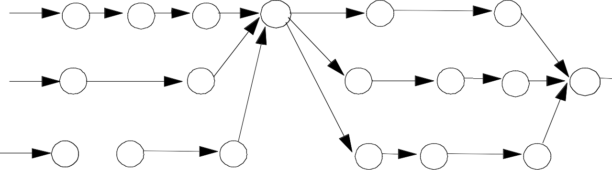
Ordering
P₀:
R
R
R
W
R
R
P₁:
R
R
R
R
R
W
P₂:
R
R
R
R
R
R
Writes establish a partial order
Does not constrain ordering of reads, though shared-medium (bus) will order read misses too
– any order of reads by different CPUs between writes is fine, so long as reads are in program order for each CPU
Writes serialized, reads and writes not interchanged, so coherent!

Slide 41
Example Write-Back Snoopy Protocol
Invalidation protocol, write-back cache
  Each cache controller snoops every address on shared bus
  If cache has a dirty copy of requested block, provides that block in response to the read request and aborts the memory access
Each memory block is in one state:
  Clean (non-dirty) in all caches and up-to-date in memory (Shared), or
  Dirty in exactly one cache (Exclusive), or
  Not in any caches
Each cache block is in one of the three states (track these):
  Shared : block can be read, OR
  Exclusive : cache has only copy, it writeable and it is dirty, OR
  Invalid : block contains no data (used in uniprocessor cache too)
Read misses: cause all caches to snoop bus
Writes to clean blocks are treated as misses (write-allocate)
Notes:
>>
This invalidation protocol uses a write-back cache.
(arrow down)
Each memory block is in one of three logical states (regardless of which cache holds it):
Clean: Non-dirty in all caches and up-to-date in memory (Shared in multiple caches).
Dirty: Dirty in exactly one cache (Exclusive in that one cache).
Not in any cache.
(arrow down)
The Cache Block States (tracked by each cache) are:
Shared (read-only):
Block can be read, but is clean (non-dirty) and up-to-date in memory.
Exclusive (writeable/dirty):
Cache has the only copy; it is writeable and dirty (not up-to-date in memory).
Invalid:
Block contains no data.
(arrow down)
Handling Read Misses and Dirty Copies
Read Misses:
Cause all caches to snoop the bus.
If a cache has a dirty copy of the requested block,
it provides the block in response to the read request and aborts the memory access.

Slide 42

Write-Back State Machine – Request from CPU
State machine for CPU requests for each
cache block
Non-resident blocks are invalid
CPU read miss
CPU read hit
Place read miss on bus
CPU Read
Place read miss on bus
Shared (read/only)
Invalid
Cache Block States
CPU Write
Place Write Miss on bus
CPU Write hit
Place invalidate on Bus CPU Write miss
Place Write Miss on Bus
CPU Read miss
Write back cache block
CPU read hit CPU write hit
Modified (read/write)
Place read miss on bus
CPU Write Miss
(if must replace this block) Write back cache block
Place write miss on bus
Notes:
>>
This Write-Back FSM shows
transitions for CPU operations (Read/Write, Hit/Miss)
between Invalid, Shared, and Modified (Exclusive/Dirty) states.
For example,
a CPU Write Hit on a Shared block
results in a Write Miss on the Bus to invalidate all other copies,
and the block becomes Modified.

Slide 43
Write-Back State Machine – Request from Bus
State machine for bus requests for each
cache block (i.e., another CPU has accessed this block)
Read miss for this block
Invalidate Write miss for this block
Invalid
Shared
(read/only)
Cache Block States
Write miss for this block
Write Back Block; (abort memory
access)
Read miss for this block
Modified
(read/write)
Write Back Block; (abort memory access)
Notes:
>>
This FSM shows
state changes due to requests from bus transactions made by other CPUs.
A Read miss from another CPU on a Modified block
forces a Write Back Block (to memory)
and the local state changes to Shared.
A Write miss from another CPU on a Shared or Modified block
forces the local state to Invalidate.

Slide 44
Example
 |  | P1 |  |  | P2 |  |  | Bus |  |  |  | Memory
step |  | State | Addr | Value | State | Addr | Value | Action | Proc. | Addr | Value | Addr | Value
P1 Write 10 to A1
P1: Read A1
P2: Read A1
P2: Write 20 to A1
P2: Write 40 to A2
P1: Write 10 to A1
P1: Read A1
P2: Read A1
P2: Write 20 to A1
P2: Write 40 to A2
Assumes A1 maps to the same cache block on both CPUs and each initial cache block state for A1 is invalid (last slide in this example also assumes that addresses A1 and A2 map to the same block index but have different address tags, so they are in different cache blocks that complete for the same location in the cache).
Notes:
A five-step example demonstrating the write-back,
invalidate protocol using addresses A1 and A2 on two processors (P1 and P2).
Key events: (slides 43 through 49)
P1 Writes 10 to A1, puts A1 in Exclusive state.
P1 Reads 10 from A1
P2 Reads A1, puts RdMs (read miss) on bus;
P1 changes from Exclusive to Shared and writes A1:10 back to memory.
P2 receives the data and is also Shared.
P2 Writes 20 to A1, puts WrMs (write miss) on bus;
P1 changes to Invalid and P2 becomes Exclusive with A1:20.
P2 Writes 40 to A2, assumes A1 and A2 map to the same cache line.
P2's dirty A1 block is first written back to memory, then A2 is allocated in the Exclusive state.

Slide 45
Example
 |  | P1 |  |  | P2 |  |  | Bus |  |  |  | Memory
step |  | State | Addr | Value | State | Addr | Value | Action | Proc. | Addr | Value | Addr | Value
P1 Write 10 to A1 |  | Excl. | A1 | 10 |  |  |  | WrMs | P1 | A1
P1: Read A1
P2: Read A1
P2: Write 20 to A1
P2: Write 40 to A2
P1: Write 10 to A1
P1: Read A1
P2: Read A1
P2: Write 20 to A1
P2: Write 40 to A2
Assumes A1 maps to the same cache block on both CPUs
Notes:
P1 Writes 10 to A1,
puts A1 in Exclusive state.

Slide 46
Example
 |  | P1 |  |  | P2 |  |  | Bus |  |  |  | Memory
step |  | State | Addr | Value | State | Addr | Value | Action | Proc. | Addr | Value | Addr | Value
P1 Write 10 to A1 |  | Excl. | A1 | 10 |  |  |  | WrMs | P1 | A1
P1: Read A1 |  | Excl. | A1 | 10
P2: Read A1
P2: Write 20 to A1
P2: Write 40 to A2
P1: Write 10 to A1
P1: Read A1
P2: Read A1
P2: Write 20 to A1
P2: Write 40 to A2
Assumes A1 maps to the same cache block on both CPUs
Notes:
P1 Reads 10 from A1

Slide 47
Example
 |  | P1 |  |  | P2 |  |  | Bus |  |  |  | Memory
step |  | State | Addr | Value | State | Addr | Value | Action | Proc. | Addr | Value | Addr | Value
P1 Write 10 to A1 |  | Excl. | A1 | 10 |  |  |  | WrMs | P1 | A1
P1: Read A1 |  | Excl. | A1 | 10
P2: Read A1 |  |  |  |  | Shar. | A1 |  | RdMs | P2 | A1
 |  | Shar. | A1 | 10 |  |  |  | WrBk | P1 | A1 | 10 | A1 | 10
 |  |  |  |  | Shar. | A1 | 10 | RdDa | P2 | A1 | 10 | A1 | 10
P2: Write 20 to A1
P2: Write 40 to A2
P1: Write 10 to A1
P1: Read A1
P2: Read A1
P2: Write 20 to A1
P2: Write 40 to A2
Assumes A1 maps to the same cache block on both CPUs.
Note: in this protocol the only states for a valid cache block are “modified” and “shared”, so each new reader of a block assumes it is “shared”, even if it is the first CPU reading the block. The state changes to “modified” when a CPU first writes to the block and makes any other copies become “invalid”. If a dirty cache block is forced from “modified” to “shared” by a RdMiss from another CPU, the cache with the latest value writes its block back to memory for the new CPU to read the data.
Notes:
P2 Reads A1,
puts RdMs (read miss) on bus;
P1 changes from Exclusive to Share
and writes A1:10 back to memory.
P2 receives the data and is also Share.

Slide 48
Example
 |  | P1 |  |  | P2 |  |  | Bus |  |  |  | Memory
step |  | State | Addr | Value | State | Addr | Value | Action | Proc. | Addr | Value | Addr | Value
P1 Write 10 to A1 |  | Excl. | A1 | 10 |  |  |  | WrMs | P1 | A1
P1: Read A1 |  | Excl. | A1 | 10
P2: Read A1 |  |  |  |  | Shar. | A1 |  | RdMs | P2 | A1
 |  | Shar. | A1 | 10 |  |  |  | WrBk | P1 | A1 | 10 | A1 | 10
 |  |  |  |  | Shar. | A1 | 10 | RdDa | P2 | A1 | 10 | A1 | 10
P2: Write 20 to A1 |  | Inv. |  |  | Excl. | A1 | 20 | WrMs | P2 | A1 |  | A1 | 10
P2: Write 40 to A2
P1: Write 10 to A1
P1: Read A1
P2: Read A1
P2: Write 20 to A1
P2: Write 40 to A2
Notes:
P2 Writes 20 to A1,
puts WrMs (write miss) on bus;
P1 changes to Invalid and P2 becomes Exclusive with A1:20.

Slide 49
Example
 |  | P1 |  |  | P2 |  |  | Bus |  |  |  | Memory
step |  | State | Addr | Value | State | Addr | Value | Action | Proc. | Addr | Value | Addr | Valu
P1 Write 10 to A1 |  | Excl. | A1 | 10 |  |  |  | WrMs | P1 | A1
P1: Read A1 1 |  | Excl. | A1 | 10
P2: Read A1 |  |  |  |  | Shar. | A1 |  | RdMs | P2 | A1
 |  | Shar. | A1 | 10 |  |  |  | WrBk | P1 | A1 | 10 | A1 | 10
 |  |  |  |  | Shar. | A1 | 10 | RdDa | P2 | A1 | 10 | A1 | 10
P2: Write 20 to A1 |  | Inv. |  |  | Excl. | A1 | 20 | WrMs | P2 | A1 |  | A1 | 10
P2: Write 40 to A2 |  |  |  |  |  |  |  | WrMs | P2 | A2 |  | A1 | 10
 |  |  |  |  | Excl. | A2 | 40 | WrBk | P2 | A1 | 20 | A1 | 20
P1: Write 10 to A1
P1: Read A
P2: Read A1
P2: Write 20 to A1
P2: Write 40 to A2
Assumes A1 maps to the same cache block on both CPUs
Assumes that, like A1, A2 maps to the same cache block on both CPUs and addresses A1 and A2 map to the same block index but have different address tags, so A1 and A2 are in different memory blocks that complete for the same location in the caches on both CPUs. Writing A2 forces P2’s dirty cache block for A1 to be written back before it is replaced by A2’s soon-dirty memory block.
Notes:
P2 Writes 40 to A2,
assumes A1 and A2 map to the same cache line.
P2's dirty A1 block is first written back to memory,
then A2 is allocated in the Exclusive state.

Slide 50
In Conclusion [SMP]
“Decline” of uniprocessor's speedup rate/year => Multiprocessors are good choices for MPU chips
Parallelism challenges:
  % parallelizable, long latency to remote memory
Centralized vs. distributed memory
  Small MP limit but lower latency; need larger BW for larger MP
Message Passing vs. Shared Address MPs
  Shared: Uniform access time or Non-uniform access time (NUMA)
Snooping cache over shared medium for smaller MP by invalidating other cached copies on write
Sharing cached data ⇒ Coherence (values returned by reads to one address), Consistency (when a written value will be returned by a read for multiple addresses)
Shared medium serializes writes ⇒ Write consistency
Notes:
>>
Multiprocessors are a good choice due to the decline in uniprocessor speedup.
However, the key challenges are low application parallelism and long remote memory latency.
(arrow down)
Centralized vs. distributed memory
* Small multiprocessor limit but lower latency
* Need larger bandwidth for larger multiprocessor
Message Passing vs. Shared Address Mulitprocessors
For shared memory: Uniform access or Non-uniform access (NUMA)
(arrow down)
Snooping cache protocols are used for smaller multiprocessors via invalidation.
The difference between Coherence (same address) and Consistency (multiple addresses) is critical.

Slide 51
A Cache Coherent System Must:
Provide set of states, state transition diagram, and actions
Manage coherence protocol
  (0) Determine when to invoke coherence protocol
  (a) Find info about state of block in other caches to determine action
» whether need to communicate with other cached copies
  (b) Locate the other copies
  (c) Communicate with those copies (invalidate or update)
(0) is done the same way on all systems
  state of each cache line is maintained in the cache
  protocol is invoked if an “access fault” occurs on the line
Different approaches distinguished by (a) to (c)
Notes:
>>
The system manages coherence by:
(Defining states / FSM / actions.)
Determining when to invoke the protocol (e.g., on an "access fault").
Finding the state of the block in other caches.
Locating copies.
Communicating with copies (invalidate or update).

Slide 52
Bus-based Coherence
All of (a), (b), (c) done through broadcast on bus
  faulting processor sends out a “search”
  others respond to the search probe and take necessary action
Could do it in scalable network too
  broadcast to all processors, and let them respond
Conceptually simple, but broadcast does not scale with p
  i.e., large P swamps the system
  on bus, bus bandwidth does not scale
  on scalable network, every fault leads to at least p network transactions
For scalable coherence, have parallel paths:
  can have same cache states and state transition diagram
  different mechanisms to manage protocol
Notes:
In bus-based systems, all communication steps (finding state, locating, and communicating) are done through a broadcast on the bus.
This method does not scale with the number of processors (p) because
bus bandwidth does not scale,
and every fault results in at least p network transactions.

Slide 53
Limitations in Symmetric Shared-Memory Multiprocessors and Snooping Protocols
Single memory to accommodate all CPUs
⇒ Multiple memory banks
Bus must support both coherence traffic & normal memory traffic
⇒ Multiple buses or interconnection networks (cross bar or small point-to- point)
Example - AMD Opteron:
  Memory connected directly to each dual-core chip
  Point-to-point connections for up to 4 chips
  Remote memory and local memory latency are similar, allowing OS to view Opteron as uniform memory access (UMA) computer
Notes:
Limitations require multiple memory banks and multiple buses or interconnection networks (cross-bar or point-to-point) to accommodate all CPUs and the coherence traffic.
The AMD Opteron is an example of a point-to-point system where memory is connected to each chip,
allowing the OS to view it as a Uniform Memory Access (UMA) computer.

